Slide 1
Standards Changes that will Affect Signal Receiving Centres in Canada
Alan Cavers
Engineering Manager
Underwriters Laboratories of Canada
October 17, 2017

Slide 2
Agenda
ULC Standards under review
CAN/ULC-S301 Changes
Redundant Site requirement
Hosted Central Station
Managed Video Services
CAN/ULC-S561
Managed Facilities Voice Networks
Web Certificates and Alarm Hub
ULC Standards

Slide 3
Standards Affecting Signal Receiving Centres- Under Review
CAN/ULC-S301 – STANDARD FOR SIGNAL RECEIVING CENTRES CONFIGURATIONS and OPERATIONS (NEW)
- New Edition to be released early to mid 2018
CAN/ULC-S561 - STANDARD FOR INSTALLATION AND SERVICES FOR FIRE SIGNAL RECEIVING CENTRES AND SYSTEMS (NEW)
- New Edition to be released early to mid 2018
Important : Harmonization of the Construction Sections

Slide 4
CAN/ULC- S301 – New Edition
Key points to note: Proposed
Harmonization with S561 on the Construction
Relaxation on the Fire Separation
Expanded Section on Station Automation -
Remote Access Requirements
Hosted Central Station
Managed Video Services
Redundant Site Requirement

Slide 5
Fire Separation Requirements
Present Requirement:
Required 2 hour fire separation for the Signal Receiving Centre.
Relaxation of this requirement:
1 hour fire separation in a fully sprinklered building.

Slide 6
Remote Access Requirements
Allow remote access at different levels under controlled conditions such as:
No access to alarm operation or handling of signal from intrusion systems outside operations area.
Will allow data entry outside operations area.
Will allow dealers to create and configure new accounts.
Allow Technicians to put systems on/off tests remotely and view history.
No remote arming and disarming of alarm panels outside operations area.

Slide 7
CAN/ULC-S301 – Redundant Site Requirement
REDUNDANT SITE —
A physical location that is able to provide all of the essential functions of a signal receiving centre should an automated signal receiving centre become unable to process signals.
Requirement:
A minimum of two Signal Receiving Centres shall be provided in compliance with the applicable requirements of the Standard.
Proposed Timeframe: 5 years from the published date of this Edition

Slide 8
Redundant Site Requirement – How to Achieve?
Signal Receiving Centre builds a new site.
Utilize a different Signal Receiving Centre as a fail over point.
Utilize the services of Alarm Monitoring Software provider.
Hosted Central Station

Slide 9
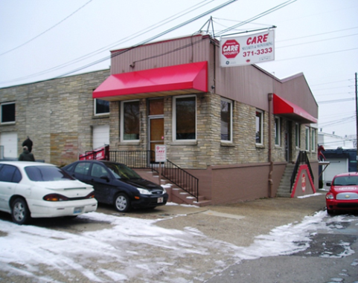
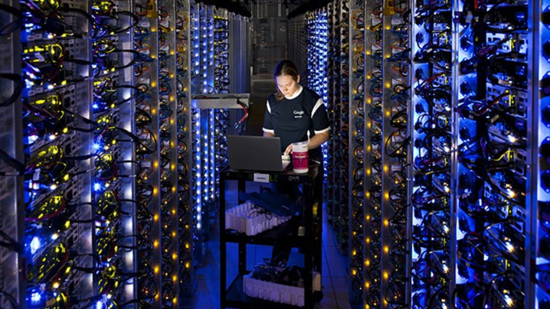
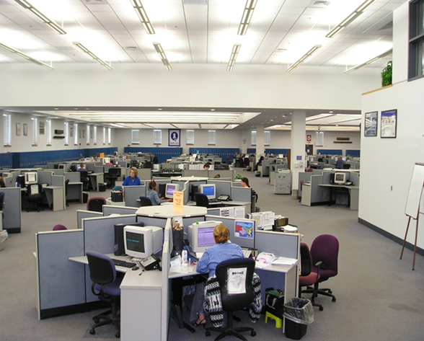
Hosted Central Station Services
Central Station Automation as a Service
+
=
to a business and its
public customers

Slide 10
Hosted Central Station Services- Canada
Canada will use CAN/ULC-S301 as the base document with additional requirements for Redundancy.
Note: In Canada these facilities are known as Signal Receiving Centres.
Provides guidance and clarification of responsibilities for Hosting partner and the public facing Signal Receiving operating company
Hosting provider held to same basic requirements as a Signal receiving Centre.
If independent data centers used for hardware & infrastructure, ULC audits the data centers on same frequency as any Signal receiving Centre.
Certification of a Hosted provider allows ULC to work directly with the Host and eliminate relevant issues from audits of the public facing Signal Receiving operating company.

Slide 11
Hosted Central Station Services
CAN/ULC-S301 - Proposed
Proposition
Automation System Servers & database maintained in redundant data centers
Signal Receiving Centre operators log into service via VPN
Customers can only access there own information
Automation Software shall be capable of separating end users.
Customers/alarm service subscribers experience no difference in service
Benefits:
Signal Receiving Centre don’t need to:
Invest and keep reinvesting in IT hardware
Patch operating systems & automation system software
Maintain IT technical expertise on above
Administer cyber-security details on automation systems

Slide 12
Managed Video Services
MANAGED VIDEO SIGNAL RECEIVING CENTRE (MVSRC) - The portion, or portions of a building, occupied by a video monitoring service company that encompasses the Centre Operations Area and the facilities essential to the operation of monitoring, processing, and disposition video signals. (Managed Video Signal Receiving Centre may be used interchangeably with Signal Receiving Centre, SRC)

Slide 13
Managed Video Services
A Managed Video Services monitoring station receives, assesses, acts upon, and retains video images received from protected properties as defined in an agreement between the company operating the monitoring station and subscribers of the monitoring services.
Early times for the technology & service
Technology allows huge variety of services
Categorization of extents of protection or grades of service very difficult
Industry suggested 3 general “types”
Triggered Events – site activation
Scheduled Events- Specific time viewing
Live View Service- medium to long term monitoring.
Other Services – As per CAN/ULC-S316 – CCTV Standard
Certificate
Allow for maximum flexibility
Characterize the “type(s)” of service
Refer to subscriber agreement for details
UL/ULC audit staff confirm/verify service delivered per service agreement

Slide 14
CAN/ULC- S561 – New Edition
Key points to note: Proposed
Harmonization with S561 on the Construction
Relaxation on the Fire Separation – Same as S301
Expanded Section on Station Automation – Same as S301
Remote Access Requirements- Same as S301
Hosted Central Station- Same As S301
Redundant Site Requirement – Same as S301

Slide 15
Fire Monitoring in Canada
Why is this important for Alarm Companies to know about Signals to the Fire Department?
If it is not ULC Certified why do I have to follow the rules?
Do I have to issue a ULC Certificate on all Fire Monitoring Installations?
Are there two sets of rules for fire monitoring?

Slide 16
Standard System in Canada for Fire Alarm System- Example
National Building Code- defines who needs a fire alarm system and/or a fire monitoring system.
National Building Code – gives reference to the installation of the fire alarm system – CAN/ULC-S524 and the Signals to the Fire Department- CAN/ULC-S561. Required for Occupancy
National Building Code – gives reference on how the fire alarm system is to be Verified prior to occupancy. CAN/ULC-S537 and CAN/ULC-S561
National Fire Code- gives reference to the ongoing maintenance of the fire alarm system –CAN/ULC-S536 and maintaining the Fire Monitoring the protected building- CAN/ULC-S561.

Slide 17
Where does it state that fire monitoring Systems shall comply? NBC 3.2.4.8
Single Stage Fire Alarm System
300 person occupancy
FAS with water-flow switches
In Ontario – High Buildings & Vulnerable Occupancies
Two Stage Fire Alarm System
First Stage- Alert has been initiated

Slide 18
Code References
NBC 3.2.4.5 (1) CAN/ULC-S524-06
NBC 3.2.4.5.(2) CAN/ULC-S537-04
NBC 3.2.4.8 (4) CAN/ULC-S561- 03 & 13
NFC 6.3.1.2. (1) CAN/ULC-S536-04
NFC 6.3.1.3 CAN/ULC-S561-03 & 13

Slide 19
What Are Some Things You Need to Know?
No Fire Alarm Verification
Signals need to be transmitted to the Fire Signal
Receiving Centre (FSRC) within 60 seconds.
FSRC shall contact the fire department in 30 seconds.
Trouble and Supervisory Signals – Contact customer within 5 minutes.
Communication Troubles- Contact Customer within 5 Minutes.

Slide 20
Exceptions.
Trouble signals from the fire alarm panel. Contact customer in 5 min
Exception: Large power outage affecting more than one property.
- Delay notification for up to 12hrs pending receipt of restoral.
- If no restoral signal received within 12 hrs. – Contact Customer

Slide 21
Exceptions
Communication troubles – Contact Customer 5 min.
Exception- Delay up to 60 minutes if Dual Communication
Channels are utilized.

Slide 22
Exceptions
Trouble Signals from Signal transmitting Units
- Contact customer within 5 min.
- Dispatch personnel to arrive within 4 hours.
Exception- In isolated areas in access of the 4 hour service
response time, permitted to exceed this time ,
Acceptance by the AHJ.

Slide 23
Certification Bulletin 2017-02A Managed Facilities Voice Networks - MFVN
MFVN Definition:
Managed Facilities-Based Voice Network (MFVN). A physical facilities-based network capable of transmitting real time signals with formats unchanged that is managed, operated, and maintained by the service provider to ensure service quality and reliability from the subscriber location to public switched telephone network (PSTN) interconnection points or other MFVN peer networks.
PSTN Definition:
Public Switched Telephone Network (PSTN). An assembly of communications equipment and telephone service providers that utilize managed facilities-based voice networks (MFVN) to provide the general public with the ability to establish communications channels via discrete dialing codes.

Slide 24
What does this mean for Signal Receiving Centres?
Introduction of Digital Phone Service for Fire monitoring.
MFVN Companies no longer provide 24 hr standby power on phone services from the central offices. Now reduced to 8 hours on average.
NFPA 72 – dealt with this 3 years ago requiring an increased frequency of testing the phone line connecting to every 6 hours instead of every 24 hours.
ULC Certificate Services adopted the same frequency on passive communication systems.

Slide 25
What does this mean under the ULC Certificate Program for fire monitoring systems?
Bulletin Dated Sept. 20, 2017
New Systems must comply.
Existing systems will need to comply in the future.
- Annual audit finding will be giving an Observation
- 1 year to comply to increase frequency.

Slide 26
Introduction of New Web Certificates & Alarm Hub

Slide 27
Web Certificates Re-launch
Web Certificates will relaunch a new web certificates portal Feb. 2018.
Alarm Hub - Link www.ul.com/alarmhubinfo
Canada to pilot first in North America.
Enhance features for a better user experience.
- Ease of use for all alarm companies
- Better Reporting for all companies – SRC and dealers
- AHJ Portal for all certificates issued in jurisdictions
- End user Portal for Insurers and Police Departments
- Instant notifications – new and canceled certificates

Slide 28
Web Certificates Relaunch Continued
Future features – Later 2018
Access to invoices
Access to annual audit reports.
Ability to close out audit findings through the portal.
And more to come as users identify other opportunities for it functionality.

Slide 29
Web Certificates & Alarm Hub
Drop by the ULC Booth for further information on the new design.

Slide 30
ULC Standards
Consensus Based
Cross section of industry must make up the Standards Committee
Who is involved in writing these Standards?
Manufacturers, Alarm Companies, End Users, Insurers/AHJ’s
Can I get involved?
YES , Contact ULC Standards if you want to comment on a Standard or be on a committee.

Slide 31
How can you get involved?
Commenting on Standards
Request from ULC Standards access to these standards for review and comment- Access granted through the portal (CSDS)
Automated notification when to comment
Request reply for your comments
New Standards- Always looking for help

Slide 32
What can happen if the rules are not followed.

Slide 33
Contact Information
THANK YOU
Contact Information
Alan Cavers, Engineering Manager,
Phone- 1-416-697-6762
E-mail alan.n.cavers@ul.com

Slide 34
THANK YOU.

